Slide 1
SDG 15.4.1: Tracking Mountain Biodiversity
Amina Ly

Slide 2
How do we track progress on protecting mountainous key biodiversity areas around the world?
Notes:
Seems easy enough.
Why?
Remind biodiversity crisis and that it’s important to protect
We now have new data, and it allows us to focus on mountainous regions (which are threatened and high in biodiversity) (find figure of biodiversity declining in mountainous regions)

Slide 3
Key Data Sources Include:
Key Biodiversity Areas (KBAs)
WCMC World Database on Protected Areas (WDPA)
Global Mountain Biodiversity Assessment Mountain Inventory (GMBA)
Notes:
TODO: Better example of the dataset with a legend
2 idealized examples and walk through them (+ a legend)
Explain each of the maps/datasets quickly

Slide 4
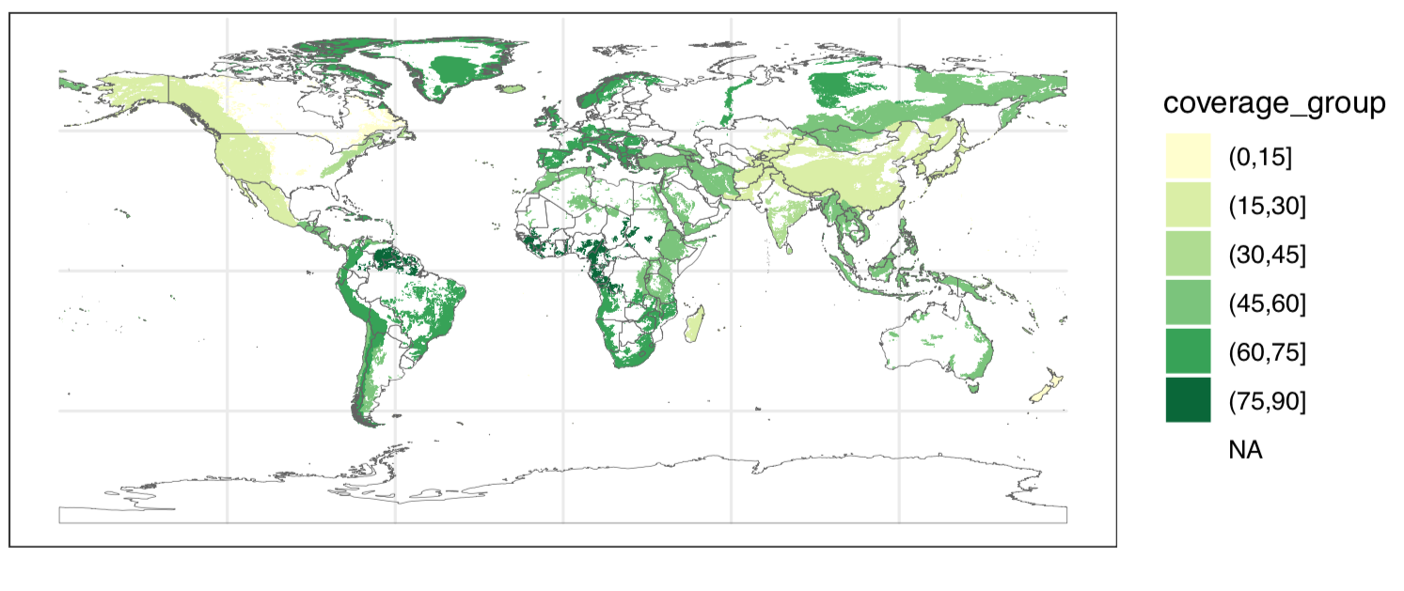
Outcomes
Communicating current progress on protecting mountainous regions
Notes:
Aggregated results
Point out a mountain range or two

Slide 5
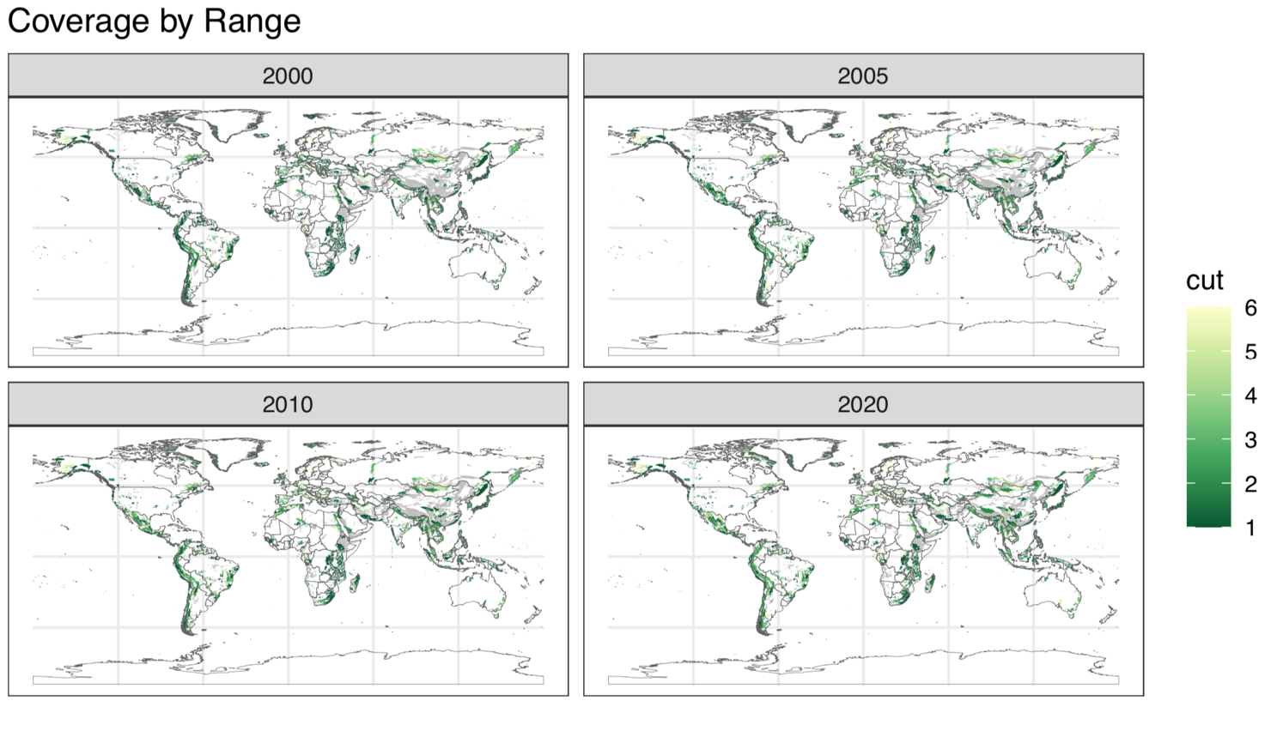
Outcomes
Glimpse into the evolution of coverage through time
Notes:
We even can see the evolution of coverage through time, and the time periods in which different areas of the world have built up their protected areas. (THIS WILL BE A GIF IDEALLY)
Pick a continent

Slide 6
Conclusion/wrap up (one sentence)

Slide 7


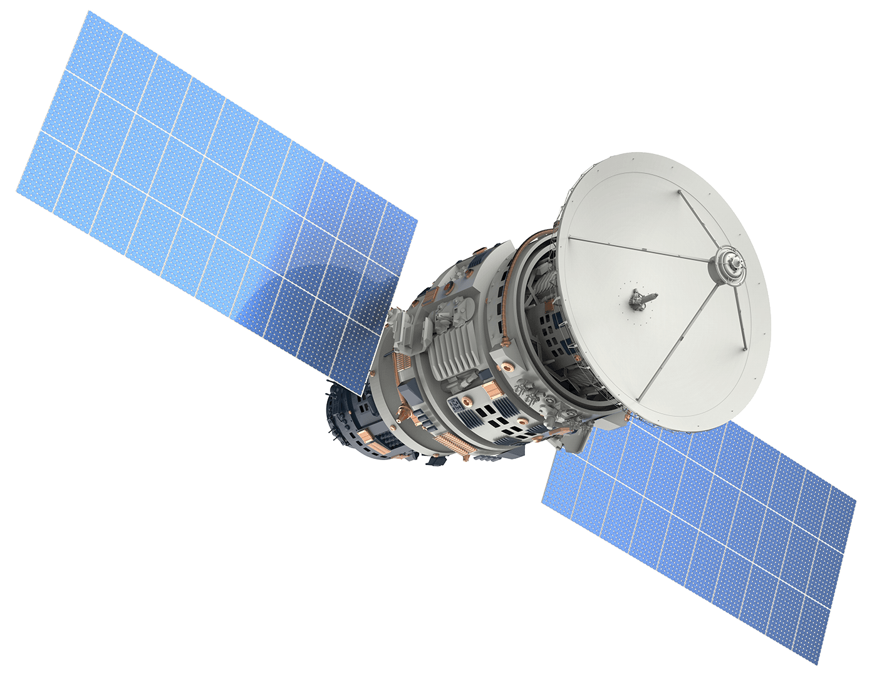
Moving Forward
Making this strategy accessible and reproducible for individual use
Online interface to communicate results
Can be combined with climate data to explore climate change vulnerability
Notes:
What is the future of this dataset?
1. make sure others can access and replicate this standard. Planning to at least have a github repo
2. create a web app for people to explore the result of the data. For those familiar, RStudio allows you to do this using by creating a shiny application
3. this can be done using current/historic data from satellites or even using future projections/scenarios

Slide 8


Thank You!
Global Sustainability Scholars
Global Mountain Biodiversity Assessment (GMBA) Team:
Davnah Urbach; Mark Snethlage; Jonas Geschke
Birdlife International
Ashley Simkins
UNEP WCMC
Cristina Lazaro
aminaly@stanford.edu
@amina6_26

